Slide 1
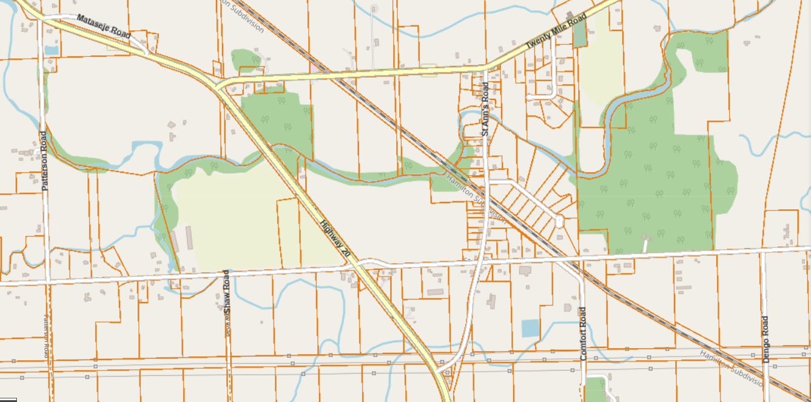
WELCOME!
ONLINE PUBLIC INFORMATION CENTER #2
St. Ann’s Road Reconstruction
Municipal Class Environmental Assessment
March 29, 2023

Slide 2
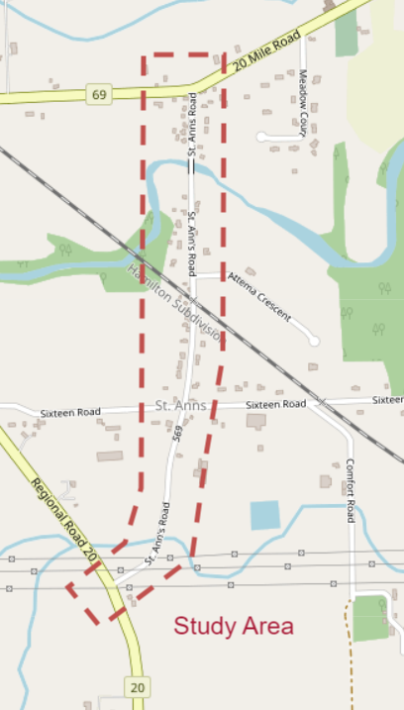
Public Information Center (PIC) 2 Format
Project Team Introduction
Presentation of PIC Materials
Forms to Submit questions and Comments
Purpose of PIC 2
To provide general update on status of the project
To present to the public the Preferred Design Solution
Provide an opportunity for the public to review project information, provide comments and ask questions

Slide 3
Core Project Team
Township of West Lincoln
Project Owner
Ray Vachon CET
Project Manager
Mike DiPaola P. Eng.
Director of Public Works and Recreation
Kerry T. Howe Engineering Ltd. (KTH)
Lead Consultant
Jeff Jaeger, P.Eng.
Design Consultant
Tyler Pitman
Project Manager

Slide 4
Key Project Team - Sub Consultants
WSP
Archaeological
Henry Cary PHD.
Sr. Staff Archaeological
WSP
Geotechnical
Taiwo Fowler EIT
Project Manager
Ellis Engineering Inc.
Structural Designer
Duane VanGeest P. Eng. Project Manager
Golder Associates Ltd.
Structural Evaluation
Jarryd A. Buck EIT
Michael P. Navarra M.A. Sc. P. Eng.

Slide 5
The Project
The Township of West Lincoln identified that St. Ann’s Road between Regional Road 20 and Twenty Mile Creek Road (RR 69) required reconstruction. The project began with the Township awarding the Municipal Class Environmental Assessment Study and Preliminary design portion of project to Kerry T. Howe Engineering Limited in June of 2021. It was decided that the project would be conducted as a Schedule “B” EA.
Projects that are conducted as an Environmental Class Assessment – Schedule “B” – typically have the potential for adverse environmental impacts. These projects must undergo a screening process that includes direct consultation with affected stakeholders and provide the stakeholders with the opportunity to be engaged during the evaluation and to be able to provide feedback as part of the evaluation process.
The first Public Information Centre was conducted in June of 2022 which provided details of the Project and Background Studies and subsequent reports, ie, Environmental, Archeological, Traffic and Bridge Condition Assessment along with Alternative Preliminary Design Solutions.

Slide 6
MUNICIPAL CLASS EA - STAGES
Phase 1
Identify Problem
Or Opportunity
Phase 2
Identify Alternative
Solutions to problem
Or Opportunity
Select Preferred
Solution
Phase 3
Identify Alternative Design
Concepts for Preferred Solution
Select Preferred Design
Preliminary Finalization of Preferred Design
Phase 4
Complete
Environmental
Study Report
(ESR)
Notice of
Completion
ESR Available
For 30 Days
May Proceed with
Detail Design
after any concerns
addressed
Phase 5
Complete Contract
Drawings & Tender
Documents
Proceed to
Construction
PROBLEM OR
OPPORTUNITY
ALTERNATE
SOLUTIONS
ALTERNATIVE DESIGN CONCEPTS FOR PERFERRED SOLUTION
ENVIRONMENTAL
STUDY
REPORT (ESR)
IMPLEMENTATION
We are here

Slide 7
Public Information Centre 1 presented 5 Design Alternatives:
Option 1 – Do-Nothing Alternative
Option 2 – 7.0m Wide Road with Curb and Gutter
Option 3 – 8.5m Wide Road with Curb and Gutter
Option 4 – 8.5m Wide Road without Curb and Gutter
Option 5 – 10.0m Wide Road with Curb and Gutter
Pros and Cons for all Alternatives were identified and evaluated, and the Preferred Preliminary Design Option 2 was chosen.

Slide 8
Design Option Evaluation Criteria
Evaluation criteria have been developed and are shown below. The Alternative Solutions will be evaluated against these criteria.
Transportation | Natural | Socio-Economic | Costs
Traffic Demand Safety Active Transportation Transit | Environmental Impact | Supports local Growth and Development Impact to Adjacent Properties ROW Availability Utility Impact | Capital Costs Maintenance Costs

Slide 9
Evaluation Table: Transportation & Engineering
 | 1. Do Nothing | 2. 7m Road | 3. 8.5m Road with Curb and Gutter | 4. 8.5m Road without Curb and Gutter | 5. 10m Road
Traffic Demand
Safety
Active Transportation
Transit
SUMMARY

Slide 10
Evaluation Table: Socio-Economic Environment
 | 1. Do Nothing | 2. 7m Road | 3. 8.5m Road with Curb and Gutter | 4. 8.5m Road without Curb and Gutter | 5. 10m Road
Environmental Impact
Supports Local Growth and Development
Impact to Adjacent Properties
ROW Availability
Utility Impact
Summary

Slide 11
Evaluation Table: Cost
 | 1. Do Nothing | 2. 7m Road | 3. 8.5m Road with Curb and Gutter | 4. 8.5m Road without Curb and Gutter | 5. 10m Road
Capital Costs
Maintenance Costs
SUMMARY

Slide 12
PREFERRED PRELIMINARY DESIGN -7.0m Wide Road
Least impact on adjacent properties and utilities
Cyclists will have to share the road with motorists
Sidewalk will remain in same location but be protected by a standard barrier curb
Approximately 8 utility poles will be in conflict and require relocation
The storm sewer would need to be extended or replaced
Minimal property impact. The utility relocations may require easements
Minimal impact to existing gardens and trees

Slide 13
NEXT STEPS
The next steps in the Municipal Class EA Planning and Design project are:
Record, compile and address any questions / comments received from this final Public Information Center
Issue Notice of Completion
Finalize, compile and file the Environmental Study Report (ESR)
The ESR is available for 30-day review period
Following the 30 day review period the Township may proceed with Detail Design and Construction Phases

Slide 14
Questions

