Slide 1
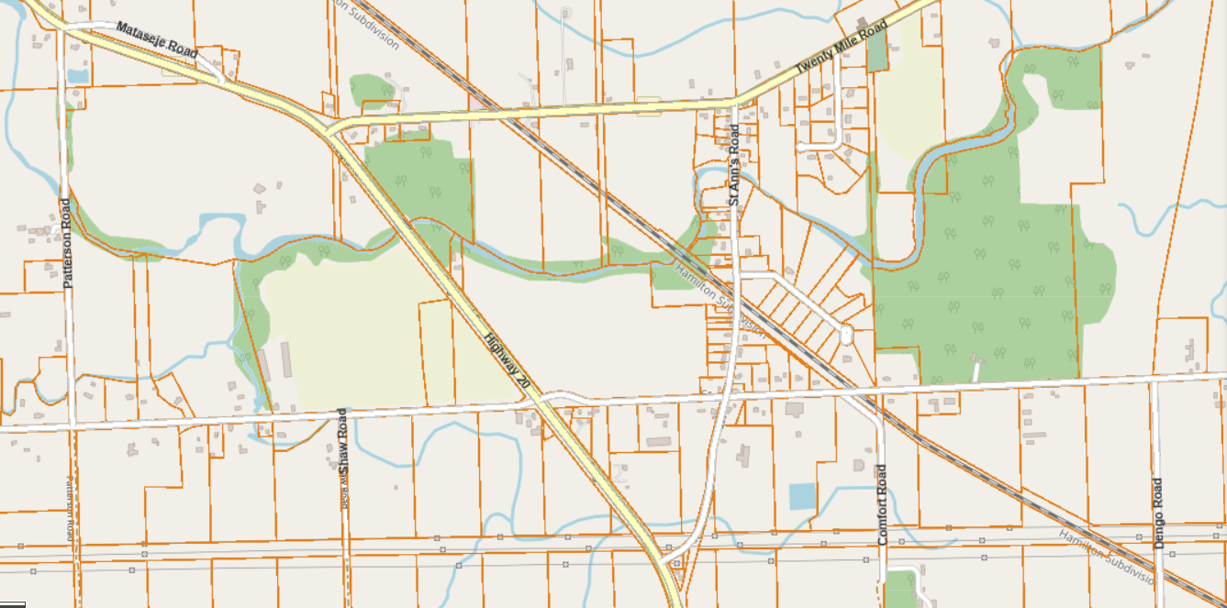


WELCOME!
ONLINE PUBLIC INFORMATION CENTER 1
St. Ann’s Road Reconstruction
Municipal Class Environmental Assessment
June 28, 2022

Slide 2
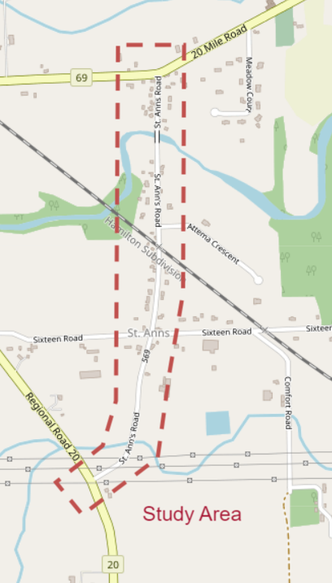
Public Information Center (PIC) 1 Format
Project Team Introduction
Presentation of PIC Materials
Online Forms to Submit questions and Comments
Purpose of PIC 1
To provide general inventory of existing conditions
To present and receive public input on identification, evaluation, and selection of alternative solutions
Provide an opportunity for the public to review project information, provide comments and ask questions

Slide 3
Core Project Team
Township of West Lincoln
Project Owner
Ray Vachon CET
Project Manager
Mike DiPaola P. Eng.
Director of Public Works and Recreation
Kerry T. Howe Engineering Ltd. (KTH)
Lead Consultant
Scott Kozub P. Eng.
Design Consultant

Slide 4



Key Project Team - Sub Consultants
WOOD
Archaeological
Henry Cary PHD.
Sr. Staff Archaeological
WOOD
Geotechnical
Thomas Ring P.Eng.
Sr. Geotechnical Engineer
Ellis Engineering Inc.
Structural Designer
Duane VanGeest P. Eng. Project Manager
Golder Associates Ltd.
Structural Evaluation
Jarryd A. Buck EIT
Michael P. Navarra M.A. Sc. P. Eng.

Slide 5
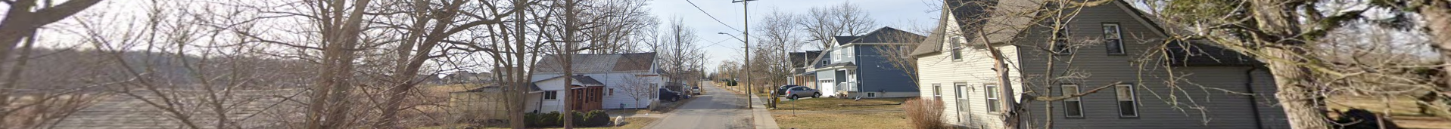
What is an Environmental Class Assessment?
The purpose of the Ontario Environmental Assessment Act (EA Act) is “the betterment of the people of the whole or any party of Ontario by providing protection, conservation and wise management in Ontario of the environment.” Environment is applied broadly and includes the natural, social, cultural, built and economic components.
Environment Assessment (EA) is a decision-making process to promote good environmental assessment planning. The key features are:
Early Consultation
Consideration of a reasonable range of alternatives
Assessment of Environmental effects
Systematic evaluation of alternatives
Clear documentation and traceable decision making

Slide 6
What is an Environmental Class Assessment Schedule?
Class Environmental Assessments (EA’s) are separated into 4 classes. The class determines the level of engagement that the various stakeholders are to have during the evaluation process. The Class is determined by the type, projected cost and environmental and social impact the project will have.
Projects such as typical maintenance to roads and drainage systems typically have minimal impact and do not require much stakeholder engagement as the impact is minimal.
Some projects require the evaluation of various design options and have higher levels of stakeholder impacts. These projects must provide stakeholders with the opportunity to be engaged during the evaluation and to be able to provide feedback as part of the evaluation process.

Slide 7
Environmental Class Assessment Schedules
Schedule ‘A’ - Maintenance, operational and emergency activities
      These are Pre-Approved and do not require approval under the EA act
Schedule ‘A+’ - These projects are also Pre-Approved, but stakeholders are to be notified prior to construction
Schedule ‘B’ - These projects have the potential for adverse environmental impacts. These projects must undergo a screening process that includes direct consultation with affected stakeholders
Schedule ‘C’ - These projects will have a significant environmental impact. These projects require additional public consultation beyond a Schedule ‘B’
This Project is Being Conducted as a Schedule ‘B’ EA!

Slide 8
Municipal Class Environmental Assessment Process
FALL 2021 | SUMMER / FALL 2022
PHASE 1: IDENTIFY PROBLEM OR OPPORTUNITY Development of statement of the problem or opportunity being addressed Notice of Study Commencement sent out to Stakeholders Development of Clear statement of the problem or opportunity being addressed | PHASE 2: IDENTIFY & EVALUATE ALTERNATIVE SOLUTIONS Identification of alternative solutions to the problem Confirm EA Schedule Prepare a general inventory of the natural, social and economic environment Identification of the net positive and negative impacts each alternative solution will have and identify mitigating measures Evaluation of all reasonable alternatives Consultation with review agencies and stakeholders Selection of the preferred solution Notice of Completion Finalization of the project file and 30-day review period
WE ARE HERE

Slide 9
Existing Conditions / Concerns
Deteriorating Road Surface
Bridge approaching the end of its life cycle
Narrow Right of Way (ROW) constraining reconstruction options
Sightline concerns at the rail crossing
Narrow road provides little space for cyclists and motorists to share the road
Unprotected utility poles within the clear zone
Inadequate storm drainage facilities
Problem Statement
This project aims to improve the quality, life cycle, and reliability of the roadway and bridge by ensuring structural pavement adequacy that meets today’s engineering standards and by providing a safe road corridor for all users including motorists, cyclists and pedestrians.

Slide 10
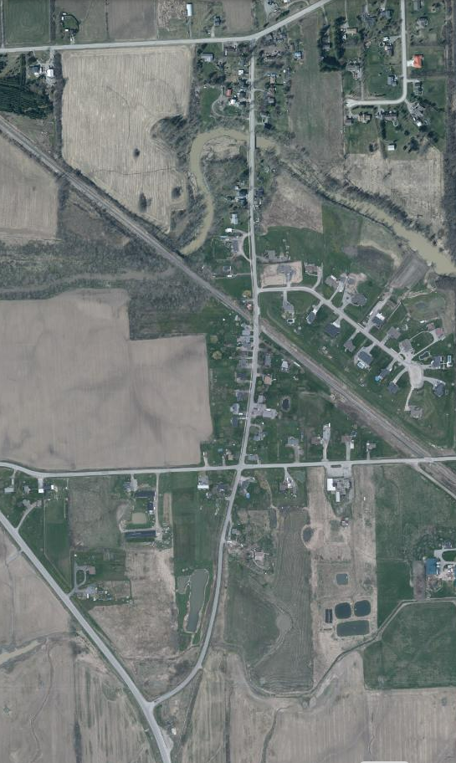
Background Studies and Reports
Twenty Mile Rd
Traffic Analysis - Sixteen Road to Regional Road 20
Traffic data collected by the municipality from the period of Feb 11th, 2022 to March 25th, 2022.
Data was analyzed utilizing Huston Radar Stats Pro Software
Results indicated an average speed of 49.2 km/hr and an 85th percentile speed of 68 km/hr
Average daily traffic count of 172.7 vehicles
St. Ann’s Rd
Attema Cres
Sixteen Rd
Regional Road 20

Slide 11
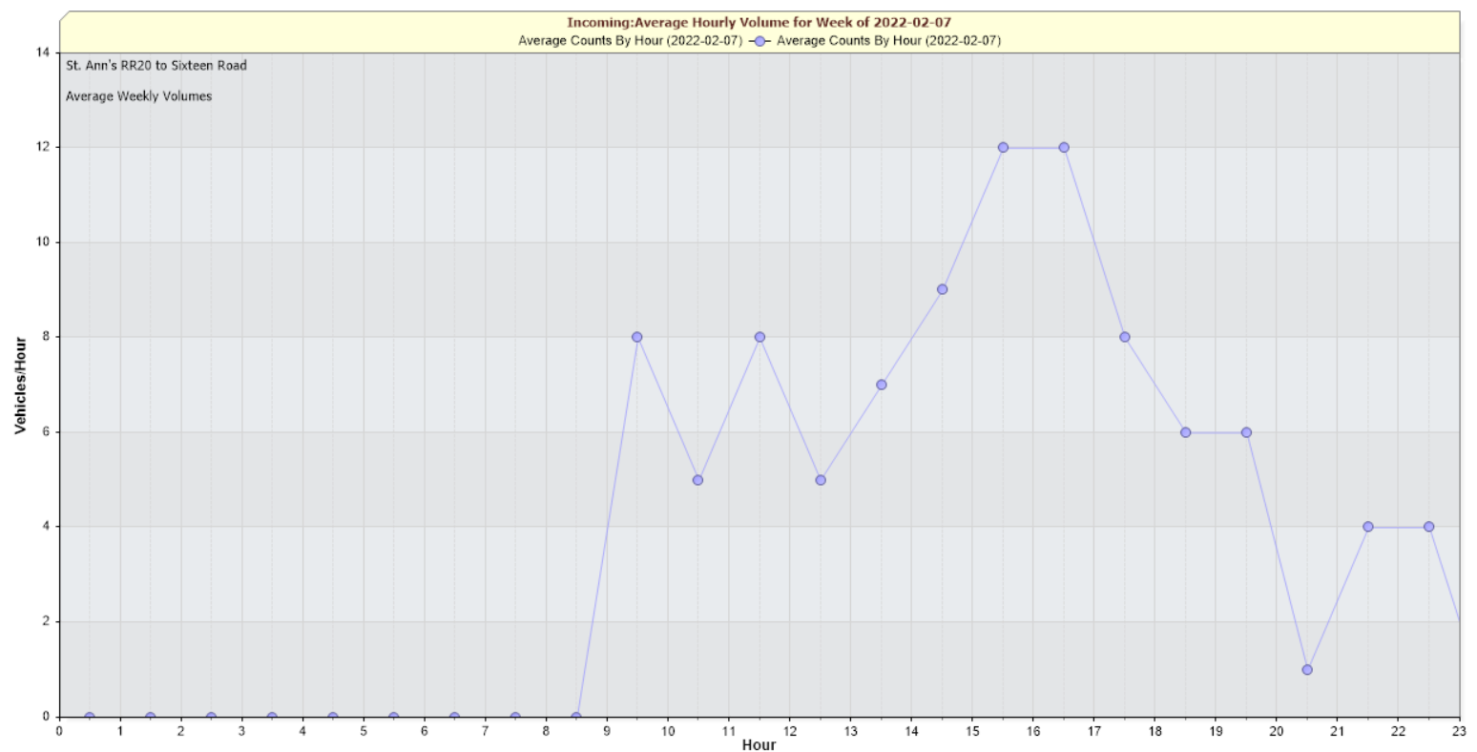
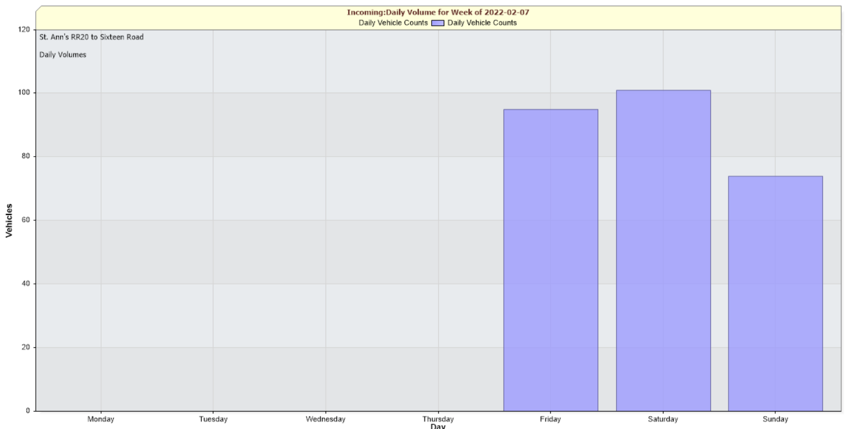
Background Studies and Reports
Traffic Analysis - Sixteen Road to Attema Crescent
Traffic data collected by the municipality from the period of Apr. 28th 2021 to March 25th, 2022.
Data was analyzed utilizing Huston Radar Stats Pro Software
Results indicated an average speed of 60.2 km/hr and an 85th percentile speed of 86 km/hr
Average daily traffic count of 102.2 vehicles

Slide 12
Background Studies and Reports
Traffic Analysis - Attema Crescent to Regional Road 69
Traffic data collected by the municipality from the period of Apr. 28th 2021 to April 7th, 2022.
Data was analyzed utilizing Huston Radar Stats Pro Software
Results indicated an average speed of 59.4 km/hr and an 85th percentile speed of 85 km/hr
Average daily traffic count of 119.9 vehicles

Slide 13
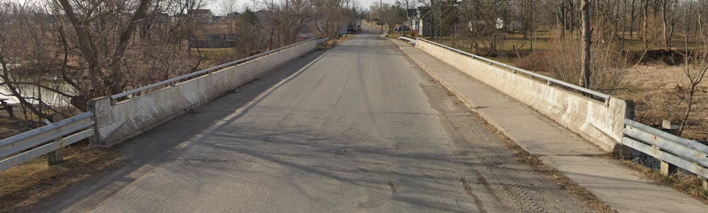
Bridge Condition Assessment Structure #46
Bridge Condition Survey Conducted on July 27, 2021 by Golder Associates Ltd.
Survey looks at wearing surface, approach slabs, expansion joints, drains, curbs, wing walls and sidewalk etc.
Recommendations:
  Minor Rehabilitation – Would Require Full Replacement in +/- 20 years
  Major Rehabilitation – Would Require Full Replacement in +/- 30 years
  No Rehabilitation – Would Require Full Replacement in 5 years

Slide 14
Alternative Solutions – Regional Road 20 to Sixteen Road
No. | Alternative Solution | Description
1 | Do Nothing | The existing road platform is not changed (this alternative will form a baseline for comparison of alternative solutions)
2 | 7m Road / Granular Shoulders | Proposed design consists of 2 – 3.5m lanes for a 7.0m wide asphalt road. Ditches will require cleaning and regrading and may require realignment due to the widening of the road surface

Slide 15
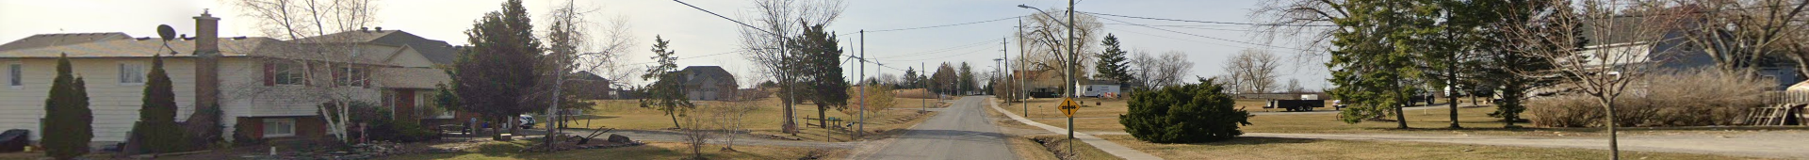
Alternative Solutions – Sixteen Road to Twenty Mile Road
No. | Alternative Solution | Description
1 | Do Nothing | The existing road platform is not changed (this alternative will form a baseline for comparison of alternative solutions)
2 | 7m Road | Proposed design consists of 2 – 3.5m asphalt lanes with 150mm barrier curb and a 1.5m wide concrete sidewalk in the western boulevard
3 | 8.5m Road with Curb and Gutter | Proposed design consists of 2 – 4.25m asphalt lanes with a standard barrier curb and gutter and a 1.5m concrete sidewalk in the western boulevard
4 | 8.5m Road without Curb and Gutter | Proposed design consists of 2 – 4.25m asphalt lanes without curb and gutter and a 1.5m concrete sidewalk in the western boulevard
5 | 10m Road | Proposed design consists of 2 – 3.5m asphalt lanes and two 1.5m wide bicycle lanes complete with standard barrier curb and gutter and 1.8m concrete sidewalk

Slide 16
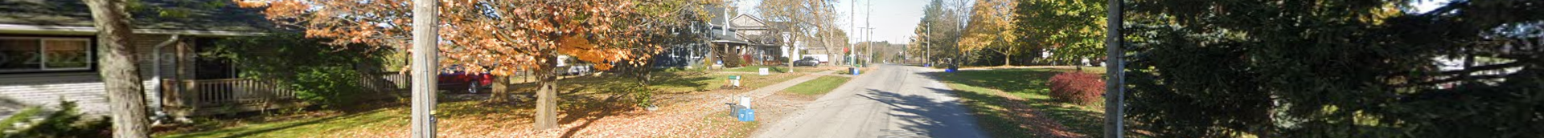
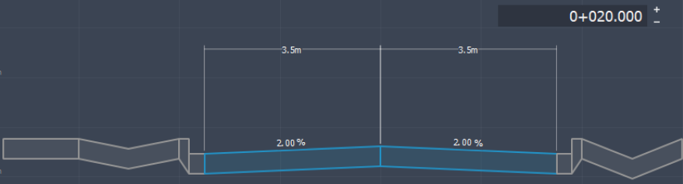
Design Specific Constraints / Concerns – 7.0m Wide Road
Least impact on adjacent properties and utilities
Cyclists will have to share the road with motorists
Sidewalk will remain in same location but be protected by a standard barrier curb
Approximately 8 utility poles will be in conflict and require relocation
The installation of subdrain may interfere with the gas mains approximately 430m
The storm sewer would need to be extended or replaced
Minimal property impact. The utility relocations may require easements
Minimal impact to existing gardens and trees

Slide 17
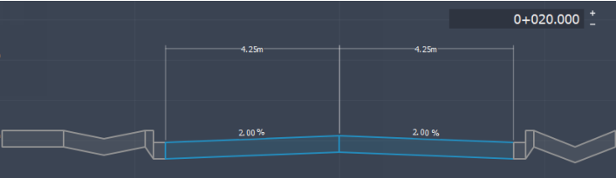
Design Specific Constraints / Concerns – 8.5m Wide Road with curb and gutter
Moderate impact on adjacent properties and utilities
More room for cyclists but not a dedicated space
Wider lanes could result in higher vehicle speeds
Sidewalk will remain in same location but be protected by a standard barrier curb
Approximately 15 utility poles will be in conflict and require relocation
The installation of subdrain may interfere with the gas mains approximately 430m
The storm sewer would need to be extended or replaced
Property likely required at #2329, #2343, #2353, #2477, #2481, #2489 and #5488

Slide 18
Design Specific Constraints / Concerns – 8.5m Wide Road without curb and gutter
Moderate impact on adjacent properties and utilities
More room for cyclists but not a dedicated space
Wider lanes could result in higher vehicle speeds
Sidewalk will remain in same location but be protected by a standard barrier curb
Approximately 13 utility poles will be in conflict and require relocation
Ditches will be placed between the sidewalk and road edge
There is no protection for pedestrians other than the ditches
Property likely required at #2329, #2343, #2353, #2477, #2481, #2489 and #5488

Slide 19
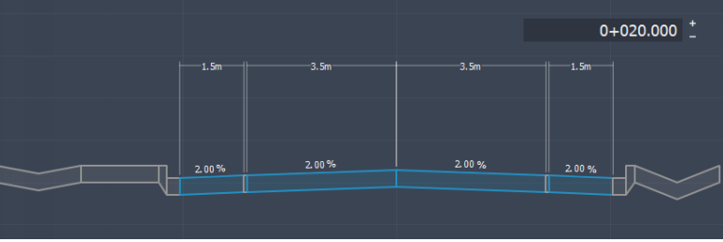
Design Specific Constraints / Concerns – 10.0m Wide Road
High impact on adjacent properties and utilities
Dedicated Space for Cyclists
Wider road could result in higher vehicle speeds
Sidewalk will be pushed the to the property line
Approximately 35 utility poles will be in conflict and require relocation
The installation of subdrain may interfere with the gas mains approximately 430m
The storm sewer would need to be extended or replaced
Property likely required at #2306, #2320, #2324, #2329, #2343, #2353, #2356, #2358, #2360, #2411, #2418, #2424, #2425, #2428, #2433, #2434, #2467, #2477, #2481, #2489 and #5488

Slide 20
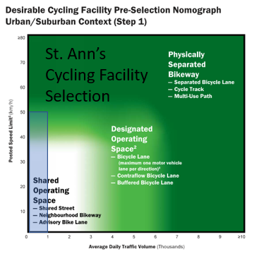
Are Bicycle Lanes Required?
MTO Book 18 Cycling Facility Design Criteria
Posted Speed Limit 50km/hr
Annual Average Daily Traffic < 1000 veh. / day
Shared operating space is recommended

Slide 21







Design Option Evaluation Criteria
Evaluation criteria have been developed and are shown below. The Alternative Solutions will be evaluated against these criteria.
Transportation | Natural | Socio-Economic | Costs
Traffic Demand Safety Active Transportation Transit | Environmental Impact | Supports local Growth and Development Impact to Adjacent Properties ROW Availability Utility Impact | Capital Costs Maintenance Costs

Slide 22
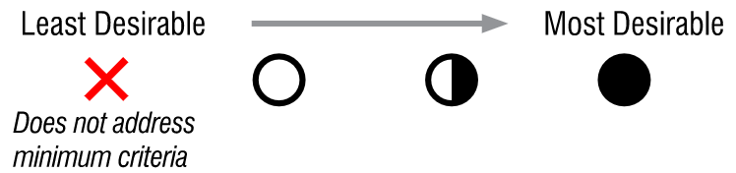




Evaluation Table: Transportation & Engineering
 | 1. Do Nothing | 2. 7m Road | 3. 8.5m Road with Curb and Gutter | 4. 8.5m Road without Curb and Gutter | 5. 10m Road
Traffic Demand
Safety
Active Transportation
Transit
SUMMARY

Slide 23
Evaluation Table: Socio-Economic Environment
 | 1. Do Nothing | 2. 7m Road | 3. 8.5m Road with Curb and Gutter | 4. 8.5m Road without Curb and Gutter | 5. 10m Road
Environmental Impact
Supports Local Growth and Development
Impact to Adjacent Properties
ROW Availability
Utility Impact
Summary

Slide 24
Evaluation Table: Cost
 | 1. Do Nothing | 2. 7m Road | 3. 8.5m Road with Curb and Gutter | 4. 8.5m Road without Curb and Gutter | 5. 10m Road
Capital Costs
Maintenance Costs
SUMMARY

Slide 25

Next Steps
Compile comments and suggestions from stakeholder input
Choose Preferred alternative
Advance design of preferred alternative
PIC 2 to present preferred alternative
Finalize Design report and post for review period
Proceed to detailed design and construction

Slide 26
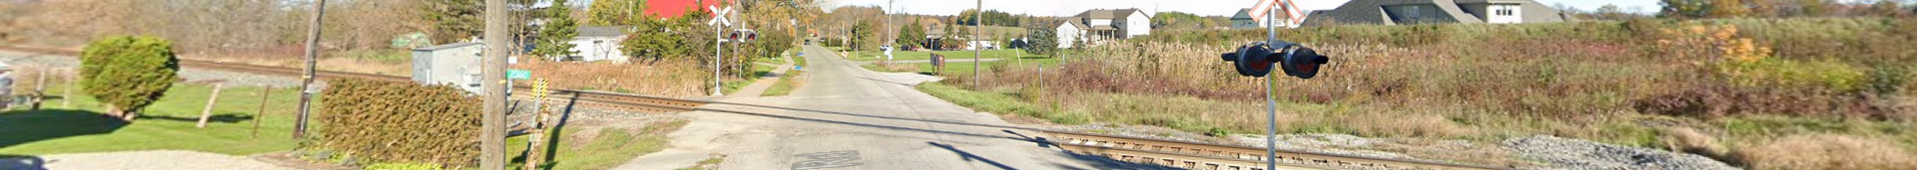





How You Can Get Involved
Ask
Fill
Request
Visit
Attend

Slide 27
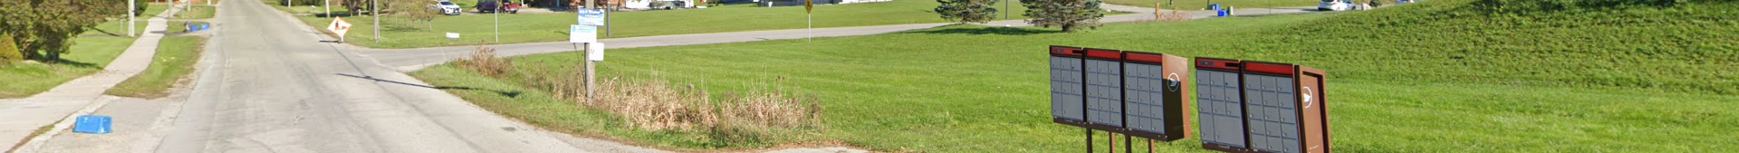
Questions

